Slide 1
Carbon Dioxide Emissions Implications if Hydrofluorocarbons are Regulated
A Comparison of Refrigerants
James Lownsbury
T_{hot}
inside freezer
T= -17 ºC
ambient air
T = 47 ºC
E
C
heat ejection medium
-23 ºC
36 ºC

Slide 2
HFC Regulation
The EPA announced last year that HFCs, CO₂, and other greenhouse gases are hazardous to human health because of their roles in global climate change.
Like CFCs before them, HFCs are likely to be regulated due to their adverse affects on the environment.
HFEs (hydrofluoroethers) are likely candidates to replace HFCs in a variety of applications, including refrigeration.

Slide 3
How does refrigeration work?
Compressor
No pressure drop through heat exchangers
P₃ = P₄
P₂ = P₁
T_{hot}
Q_{fan}
2
3
By law: T_{discharge} < 48.9 ºC
By law: T_{freezer} = -17 ºC
Worst-case:
T_{air} = 47 ºC
Evap.
Cond.
Ambient water T_{water} = 25 ºC
1
4
Freezer temperature sets the maximum refrigerant temperature T₁ = -23 ºC P₁ > 1 atm Liquid-vapor mixture
Minimum ΔT = 11 ºC T₄ = 36 ºC Must be all liquid Vapor pressure data + T₄ → P₄
Valve

Slide 4
Some equations used
→ ideal T₃ →
Major sources of indirect CO₂ emissions.
Compressor
P₂ = P₁
P₃ = P₄
Q_{fan}
2
3
T_{discharge} < 48.9 ºC
T_{freezer} = -17 ºC
Evap.
T_{air} = 47 ºC
Cond.
Ambient water T_{water} = 25 ºC
1
4
T₄ = 36 ºC
Valve
Antoine Equation:
C_{p} values for the HFE from: P. Blowers, K. F. Tetrault, Y. Trujillo-Morehead, Estimation of heat capacities for hydrofluoroethers with two carbon atoms, Ind. Engr. Chem. Res., 46, 6600-6604, (2007).

Slide 5
Global Warming Effects
Indirect CO₂ emissions:
    1.05 kg CO₂ per kWh of electricity from coal
    0.003 kg CO₂ per L of water pumped
Direct CO₂ equivalent emissions:
  9% leakage per year
    R-12 (CFC): GWP = 8100
    R-134a (HFC): GWP = 1300
    HFE-143m: GWP = 446
P. Blowers and J. Lownsbury, Carbon dioxide emission implications if hydrofluorocarbons are regulated: A refrigeration case study, Env. Sci. Technol., 44, 1526-1529 (2010).

Slide 6
Comparison of Results
Refrigerant | R-12 | R-134a | HFE-143m
W_{s,compressor} [J s⁻¹] | 19,545 | 29,259 | 33,956
m_{water} [g s⁻¹] | 625 | 802 | 897
Comp. electricity [kWh y⁻¹] | 171,214 | 256,309 | 297,455
Water movement [kWh y⁻¹] | 59,130 | 75,895 | 84,879
Electricity losses [kWh y⁻¹] | 17,872 | 25,775 | 29,664
Direct CO₂-eq. emissions | 97,920 | 21,456 | 6,966
Indirect CO₂ emissions | 260,627 | 357,877 | 432,597
Total CO₂ emissions | 358,547 | 397,933 | 439,563
Good!
From a global warming perspective, the most attractive refrigerant would be the CFC, but since CFCs are ozone depletors, the HFC would be the best choice.
Bad!

Slide 7
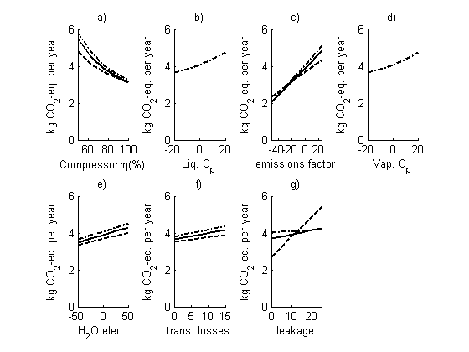
Sensitivity analyses
The solid line - current HFC (R-134a), the dashed line - phased out CFC (R-12), and the dash-dot line - likely HFE replacement (CF₃OCH₃). Indirect and direct emissions total in 10⁵ kg/year.
P. Blowers and J. Lownsbury, Carbon dioxide emission implications if hydrofluorocarbons are regulated: A refrigeration case study, Env. Sci. Technol., 44, 1526-1529 (2010).

Slide 8
Up next…
HFEs in window AC units
HFEs in car AC units
HFEs in dry cleaning applications
Questions?

